Slide 1

Intelligent Warehouse Management System
Group No. 2
Amit Prajapati (15104014)
Amisha Karia (15104008)
Dhruv Patel (15104026)
Lavina Budhwani (16204019)
Project Guide : Prof. Rujata Chaudhari & Mr. Vinayak Narkar and
Coguide: Prof.Nahid Shaikh

Slide 2
Contents
Introduction
Abstract
Proposed System
Technology Stack
Dependencies
Project Planning

Slide 3
Introduction
It is a web based application that will allow the farmers to store their crops in a warehouse. Using our system they can book space for their goods which can save both time and money of a farmers. Farmers can check availability of space and can directly approach to the nearest warehouse for storage.Our system will also help the farmers to take decision about which warehouse he should select based on the passed data analysis and geographical location using Machine Learning.

Slide 4
Abstract
The basic idea behind our project is to give an online web based application and a web site to the farmers so that he can get the storage space faster without much wasting of time, money and efforts. Our system will also give a notification to the farmer regarding the expiry of stored goods in particular warehouse according to their lifespan. Our system will be a multilingual for understanding of farmers.

Slide 5
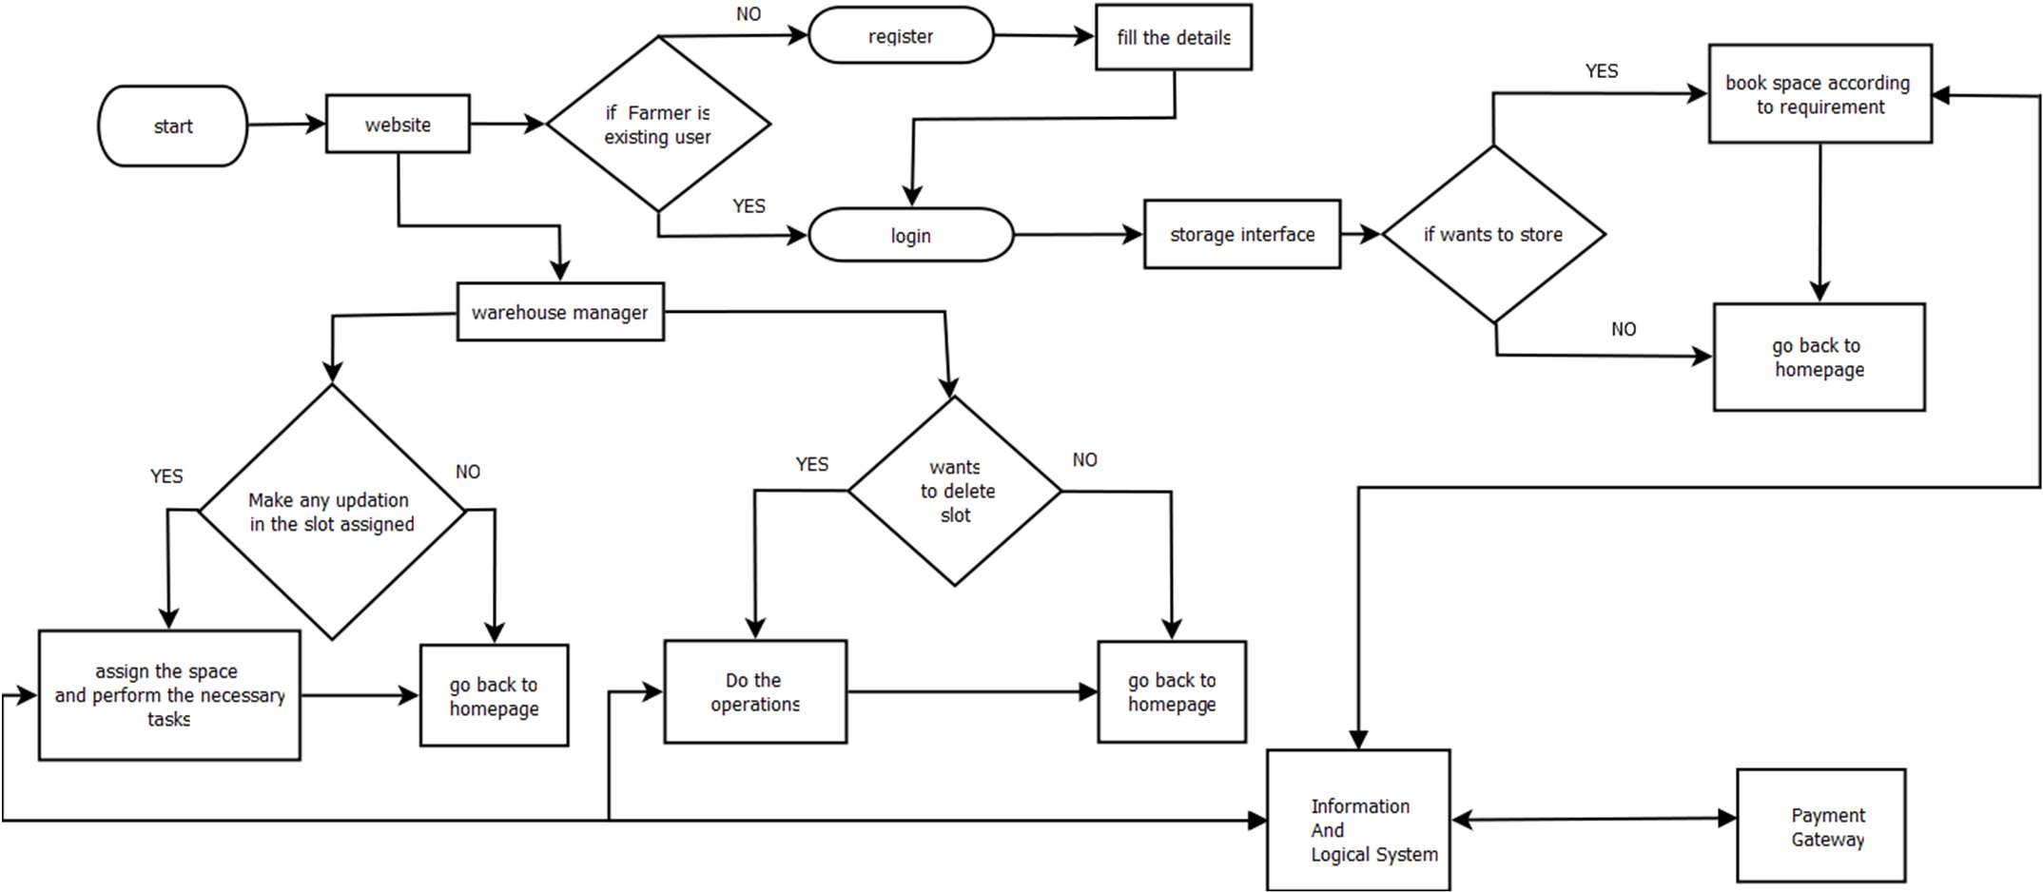
Proposed System

Slide 6
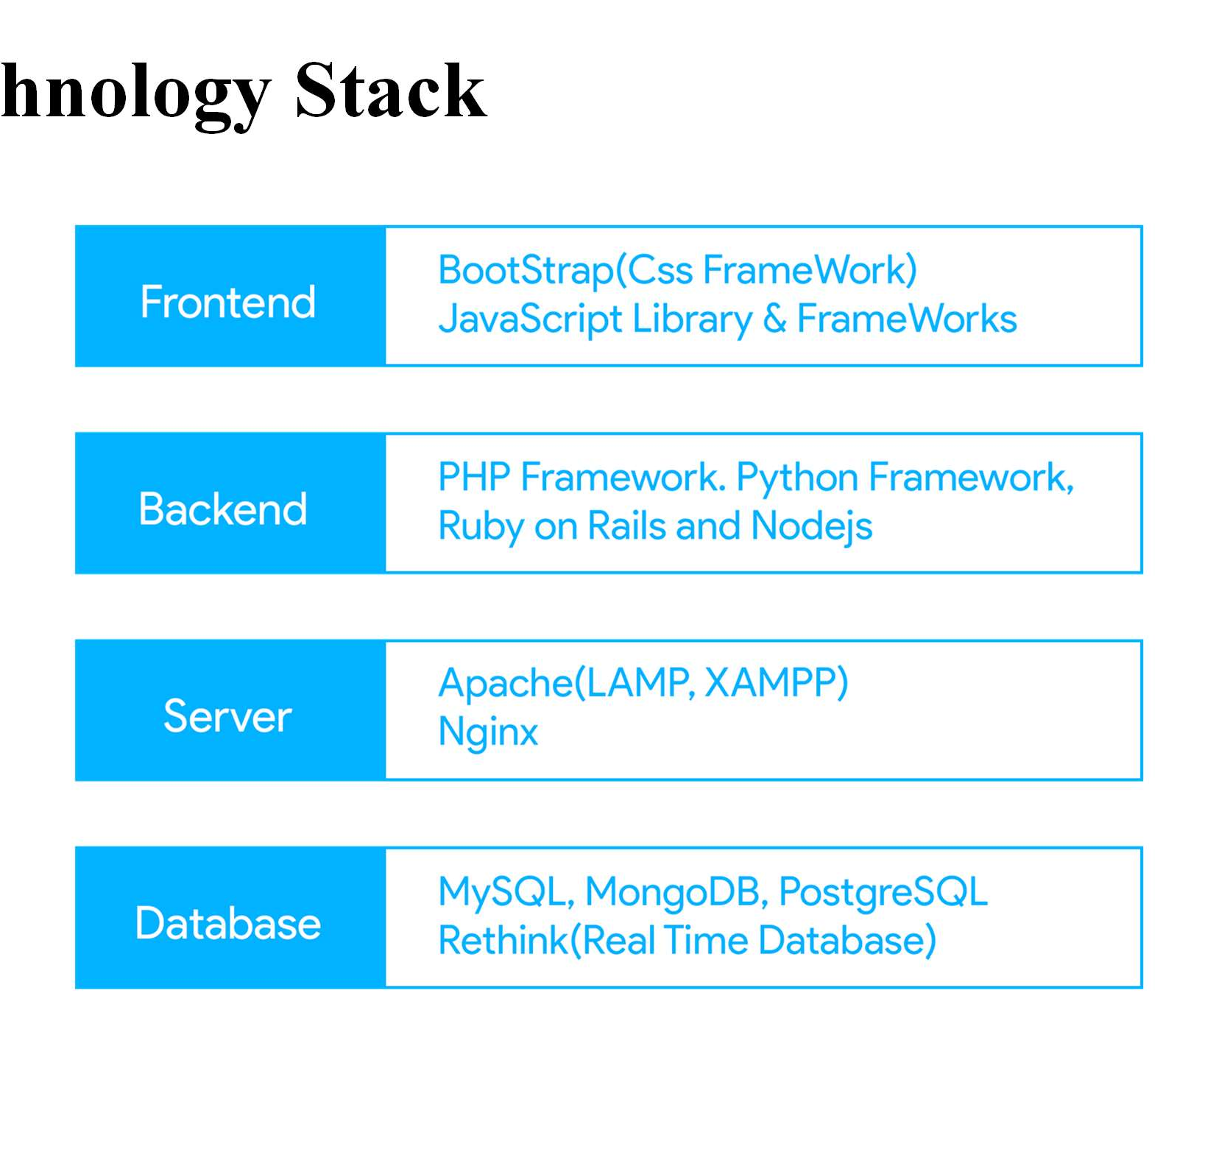
Tec
hnology Stack

Slide 7
Dependencies
Payment Gateway Integration
Weather API
Location service API

Slide 8
Project Planning
Research
Documentation
UI designing
Database Architecture designing
Coding
Integration of different modules
Testing

Slide 9
Thank you

